Slide 1
Data are just summaries of thousands of stories , tell a few of those stories to help make the data meaningful .

Slide 2
House Sales in King County Washington

Slide 3
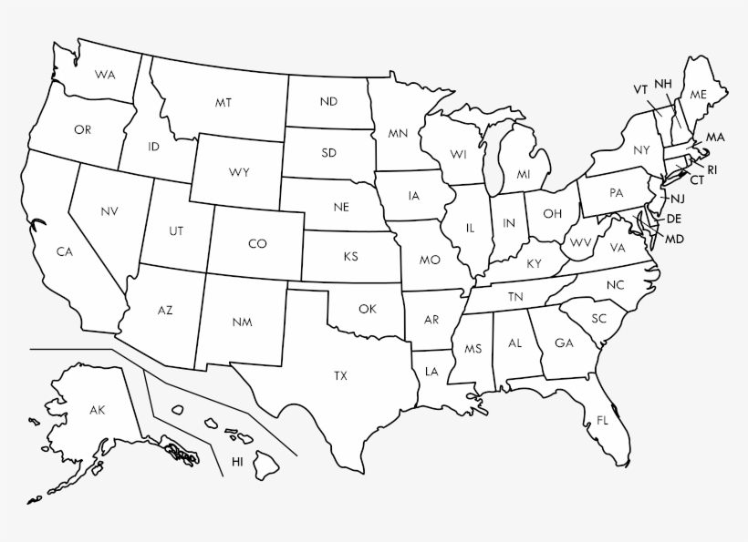
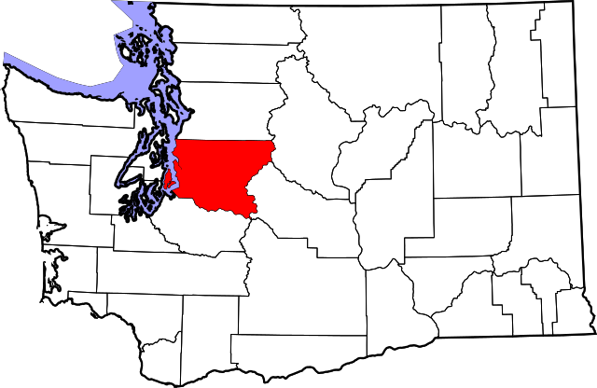


Maps

Slide 4
What we can tell about prices in (2014-2015) ?
What are the important findings we can glean ?
What are the summary statistics of this data ?
Project Goal :
Build a predictive house prices model to tell us more about house prices

Slide 5
Roadmap
Problem Definition
Exploratory Data Analysis ( EDA )
Modeling
1
3
5
2
4
6
Parts in blue for week one .
Parts in red for week two .
Data Wrangling
Pre-processing and Training data development
Documentation

Slide 6
Time-line Gantt chart
 | Week 1 |  |  |  |  |  |  | Week 2
 | 1 | 2 | 3 | 4 | 5 | 6 | 7 | 8 | 9 | 10 | 11 | 12 | 13 | 14
Problem definiton
Data Wrangling
Exploratory data analysis
Pre-processing and Training data development
Modeling |  |  |  |  |  |  |  |  | ◆
Documentation

Slide 7




What do we need to focus on ?
What are the important details to focus on in our analysis ?
House features effect house price ?

Slide 8
Data Collection
Data Organization
Data Wrangling
Data Definition
Data Cleaning

Slide 9
Data Collection :
Average house price 490K
Sales Between 2014 & 2015
21,613 House Details
Houses Built between 1900 - 2015
11.6 B $

Slide 10
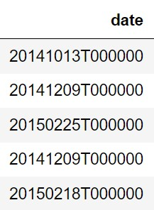
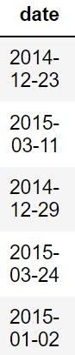
Data Organization

Slide 11
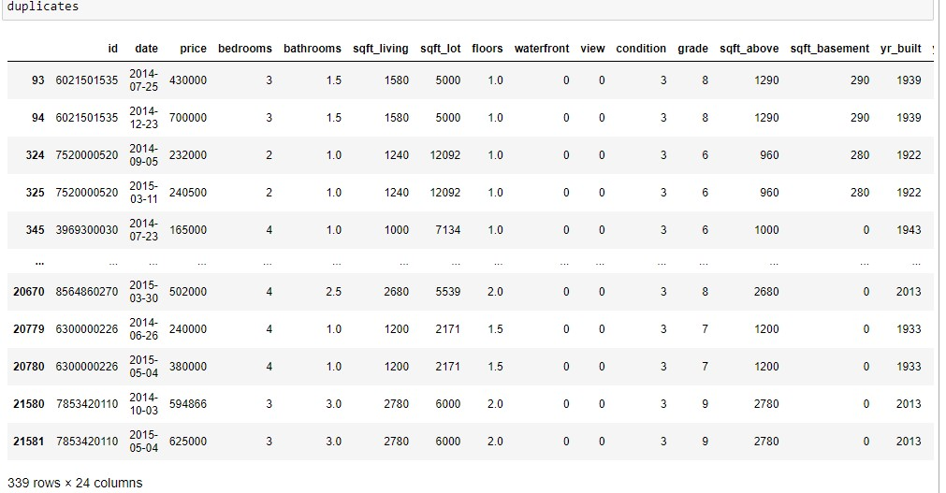
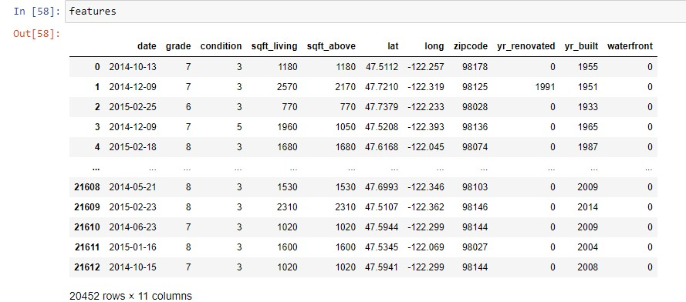
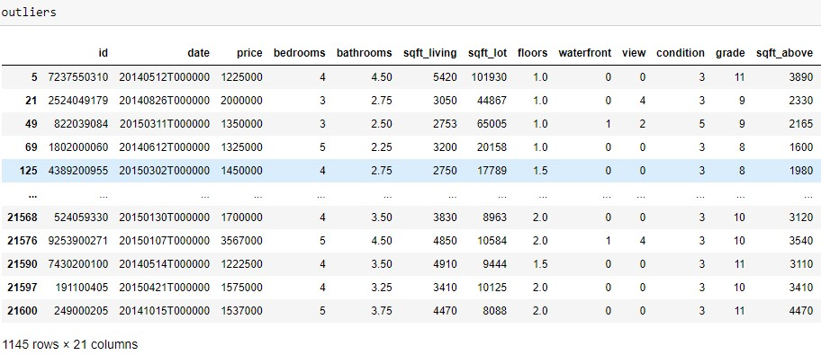
Houses sold twice data set
Data Organization
Original Data set
General data set
Price out of range data set

Slide 12
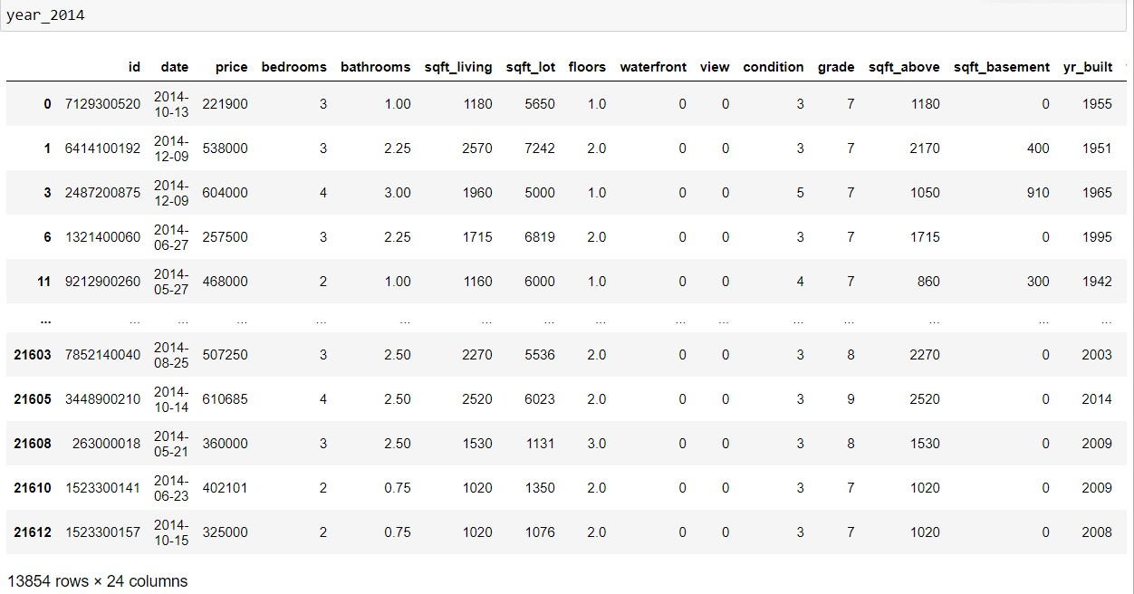
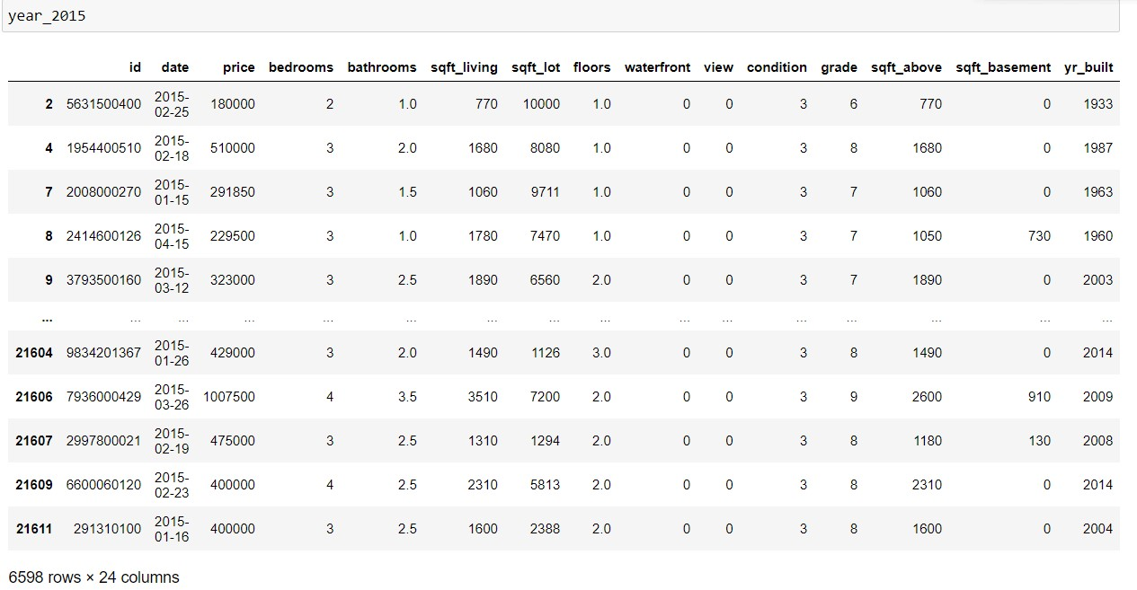
Splitting house sales to 2014 sales & 2015 sales

Slide 13
Data Definition
Name | Data Type | Range | Description
ID | Numeric | - | House ID
Price | Numeric | 75K-7.7M | House price ‘’ Target ‘’
Grade | Categorical | 3-13 | Overall grade
Condition | Categorical | 1-5 | Overall condition
Date | Time-Stamp | - | House sale date

Slide 14
Data Cleaning
Some of the houses have inaccurate information such as houses without bedrooms or bathrooms ( 0.07 % from total set )
Some of the columns where unnecessary for our analysis .
So we decided to drop them of our data set
So we decided to drop them of our data set

Slide 15
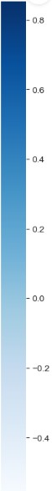
Pearson Correlation matrix
Price
Bedrooms
Bathrooms
Living area
Lot Area
floors
waterfront
What is the most important correlation between price and other characteristics ?
view
condition
grade
Area without
basement
Basement
Year built
Year renovated
ZIP code
Lateral coor
Longitude coor
Legend

Slide 16
Top 3 features correlated with price
Square-Ft living Total area of interior living space .
Square-Ft above The area of the house without the basement
Price
Grade Overall grade given to the housing unit, based on King County
grading system

Slide 17
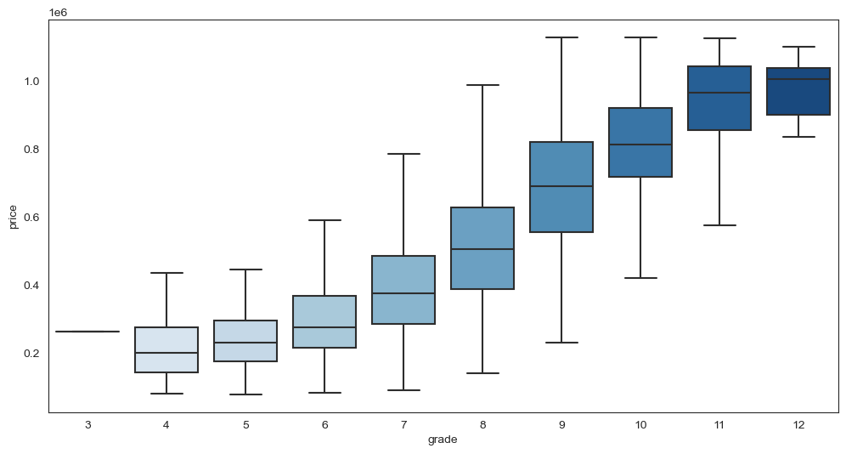
Grade and price boxplot
Grade 8 & 9 have the most price variations
We can tell that when house grade goes to higher ranks the price of the house will also goes up .
When house grade goes up , price variation will decrease .

Slide 18
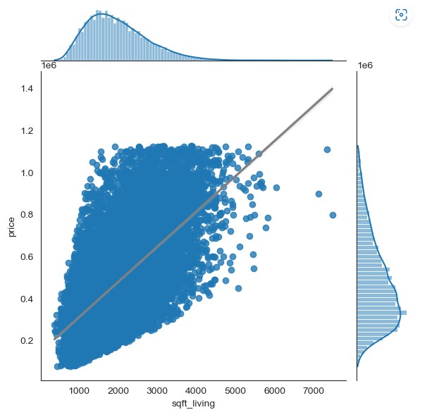
Square-ft living and price
We can tell that when house total square-ft living area increase , house price will also increase .

Slide 19
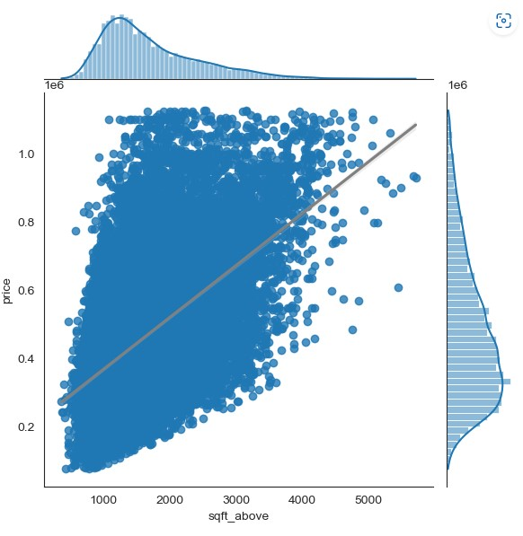
Square-ft above and price
We can tell that when house total square-ft above area increase( area without the basement ) , house price will also increase .

Slide 20
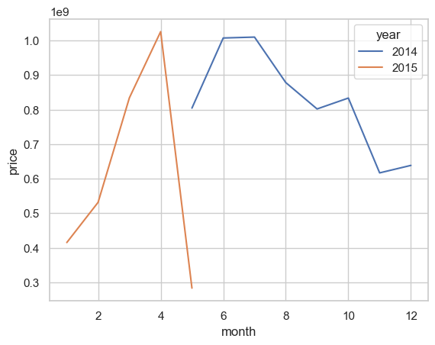
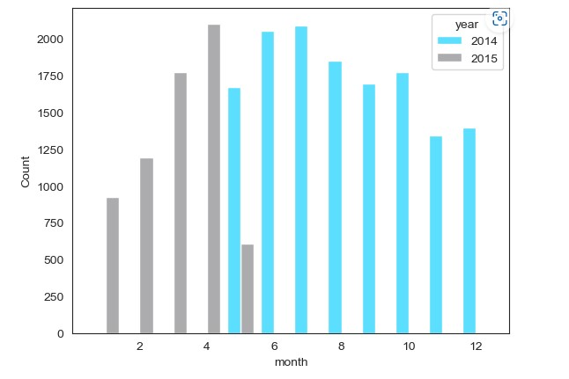
House Sales
1667(969M$)
2089(1.2B$)
1693(938M$)
1340(735M$)
925(514M$)
1772(1.02B$)
608(360M$)
2000+
1850
2014 Sales
2015 Sales
1700
1400
MAY
JUN
JUL
AUG
SEP
OCT
NOV
DEC
JAN
FEB
MAR
APR
MAY
1000
0
2054(1.21B$)
1846(1B$)
1771(1B$)
1394(771M$)
1192(634M$)
2101(1.25B$)

Slide 21
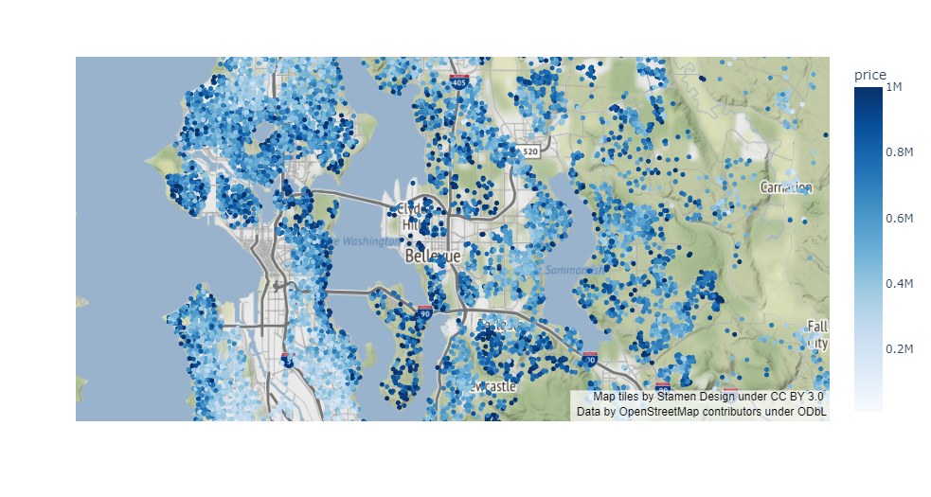
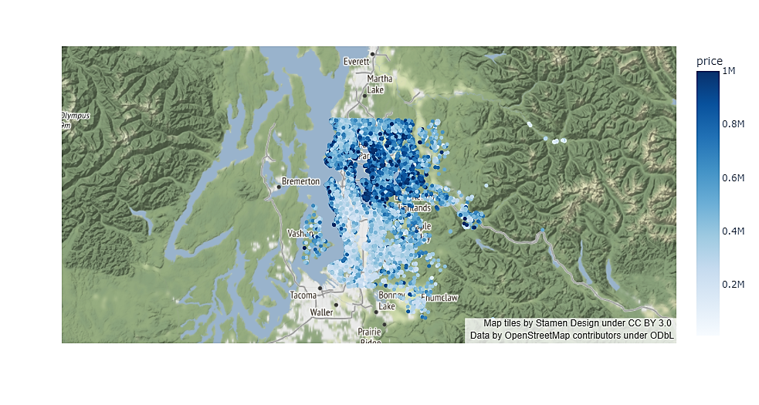
Houses Distribution
North of King County

Slide 22
Summary
The relation between house grade and price is positive .
Higher house grades have less variations in price .
Houses with larger square-ft total area have higher prices .

Slide 23

House Re-sales
* Different two samples from house re-sales
ID | Price | Date
6021501535 | 430,000 | 2014-07-25
6021501535 | 700,000 | 2014-12-23
6300000226 | 240,000 | 2014-06-26
6300000226 | 380,000 | 2015-05-04
≈ 170 House
Same houses sold twice
≈ 23,650,000 $
Price difference between initial price and final price
≈ +39 % Difference percentage for all houses .
97%

Slide 24
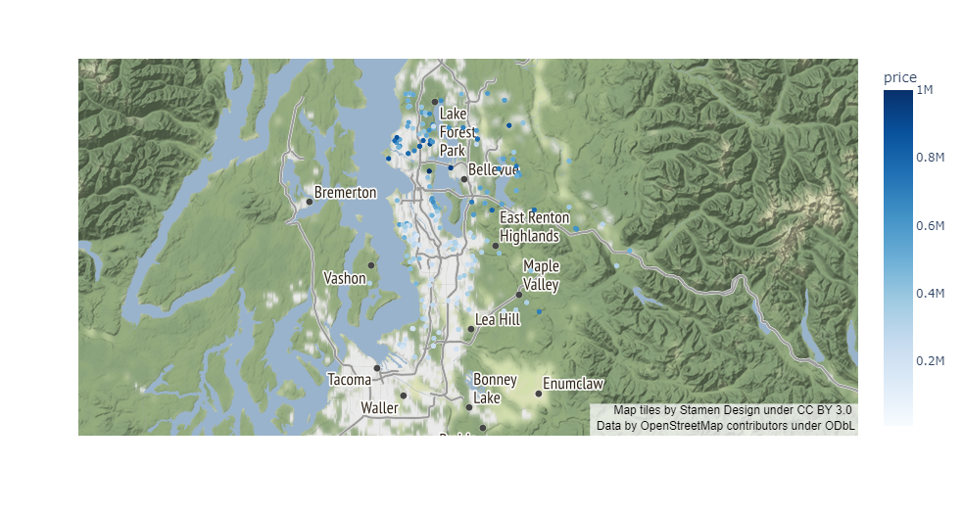
House Re-sales

Slide 25
Prices out of range
Calculating IQR and houses upper limit price :
Q1 25 percentile of the given data is 322,000 $
Q2 50 percentile of the given data is 450,000 $
Q3 75 percentile of the given data is 645,000 $
IQR = Q3-Q1
Interquartile range is 323,000 $
Price upper limit = Q3-1.5*IQR
Price upper limit = 1,130,000 $
Prices out of range
Price upper limit
Q3
13%
Q1
87%

Slide 26
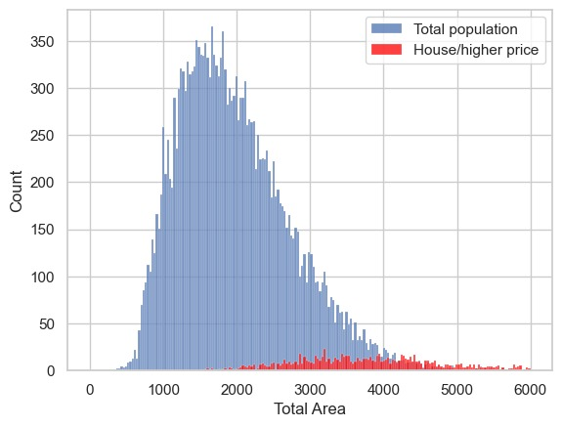
Prices out of range
Total house area is the summation of total square-ft area above the basement and basement area .
Houses have higher price have an average of 4000 square-ft in total area ( double area from the houses in average price range )

Slide 27
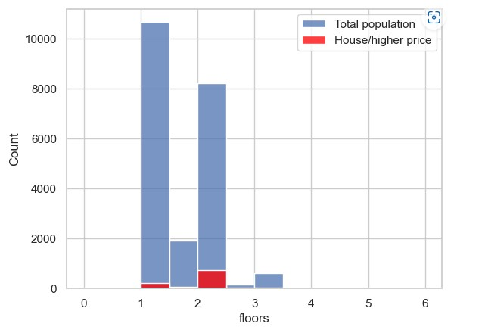
Prices out of range
Houses out of price range have an average of two floors in each house , while most of the houses have one floors .

Slide 28
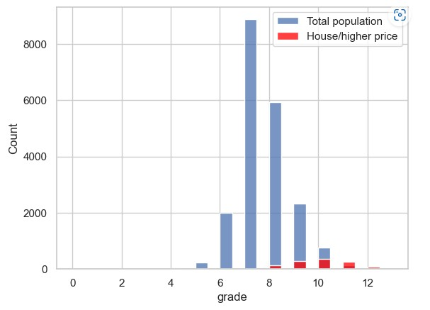
Prices out of range
Houses out of price range have a house grade of 10 , while most of the houses are grade 7 .

Slide 29
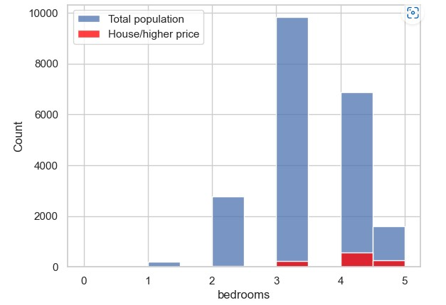
Prices out of range
Houses out of price range have an average of four bedrooms in each house , while most of the houses have three rooms .

Slide 30
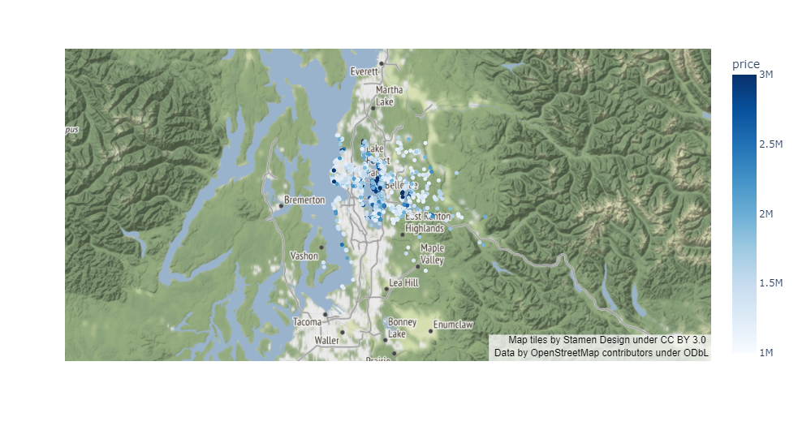
Prices out of range

Slide 31
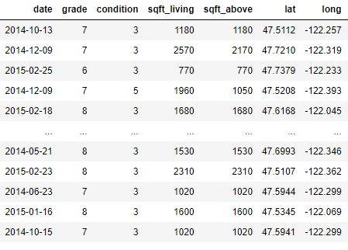
Features selection
According to our analysis we decided to use the following features in our price prediction model , which are :
1- Date of sale
2- House grade
3- Square-ft living area
4- house coordinates
5- ….. Will be chosen in next week

Slide 32



Presentation Team
Feras Al-Qrinawi
Abdullah Khader
Hamzah Jahameh

Slide 33
Thanks!
Any questions?

